Slide 1
Data Structures and Algorithms(CSE2001)
MODULE 2
Linear Data Structure- Linked List
1-<number>

Slide 2
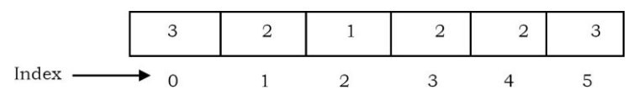
Arrays Overview
One memory block is allocated for the entire array to hold the elements of the array.
The array elements can be accessed in constant time by using the index of the particular element as the subscript.

Slide 3
Advantages of Arrays
• Simple and easy to use
• Faster access to the elements
Disadvantages of Arrays
• Preallocates all needed memory up front and wastes memory space for indices in the array that are empty.
• Fixed size: The size of the array is static (specify the array size before using it).
• One block allocation: To allocate the array itself at the beginning, sometimes it may not be possible to get the memory for the complete array (if the array size is big).
• Complex position-based insertion: To insert an element at a given position, we may need to shift the existing elements. If the position at which we want to add an element is at the beginning, then the shifting operation is more expensive.

Slide 4
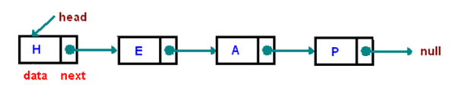
Linked List
LL - Data structure used for storing collections of data
LL - Consists of a sequence of elements where each element (called a node) comprises of two items - the data and a reference (pointer) to the next node.
The last node has a reference to null.
The entry point of linked list is called the head (start) of the list.
Head is not a separate node, but the reference to the first node.
If the list is empty then the start is a null reference.
1-<number>

Slide 5
Properties of Linked List
Successive elements are connected by pointers
The last element points to NULL
Can grow or shrink in size during execution of a program
Can be made just as long as required (until systems memory exhausts)
Does not waste memory space (but takes some extra memory for pointers). It allocates memory as list grows.

Slide 6
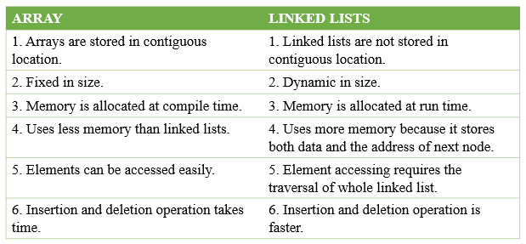
Arrays Vs Linked Lists

Slide 7
Operation of LL
Main Linked Lists Operations
  Insert: inserts an element into the list
  Delete: removes and returns the specified position element from the list
Auxiliary Linked Lists Operations
  Delete List: removes all elements of the list (disposees the list)
  Count: returns the number of elements in the list
  Find n th node from the end of the list

Slide 8
Operations on Single linked list
Creation of a list
  Creation operation is used to create a linked list. Once a linked list is created with one node, insertion operation can be used to add more elements in a node.
Insertion of an element into a linked list
  Insertion operation is used to insert a new node at any specified location in the linked list.
  A new node may be inserted.
    At the beginning of the linked list
    At the end of the linked list
    At any specified position in between in a linked list •

Slide 9
Deletion of a node from the linked list
  Deletion operation is used to delete an item (or node) from the linked list.
  A node may be deleted from
    Beginning of a linked list
    End of a linked list
    Specified location of the linked list
Traversing and displaying the elements in the list
  Traversing is the process of going through all the nodes from one end to another end of a linked list.
  In a singly linked list we can visit from lnewnode to rnewnode, forward traversing, nodes only.

Slide 10
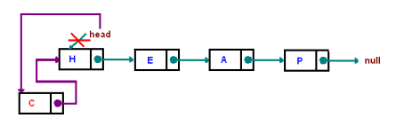
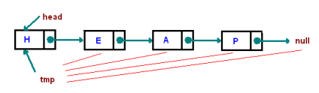
Single Linked List Basic Operations
Insertion at the beginning
  This method creates a node and inserts it at the beginning of the list.
Traversing
  Start with the head and access each node until you reach null. Do not change the head reference.

Slide 11
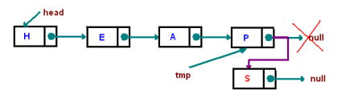
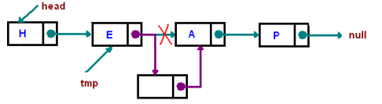
Insertion at the end
  This method appends the node to the end of the list. This requires traversing, but make sure you stop at the last node
Inserting "after“
  Find a node containing "key" and insert a new node after it. In the picture below, we insert a new node after "E"

Slide 12
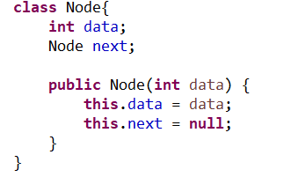

Representation of a node of Single Linked List
Representation of head / tails of Single Linked List

Slide 13
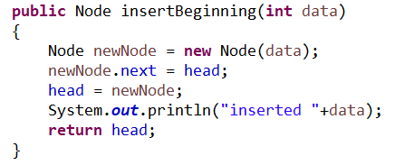
Insert @ beginning of the Single Linked List

Slide 14
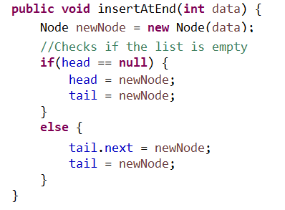
Insert @ end of the Single Linked List

Slide 15
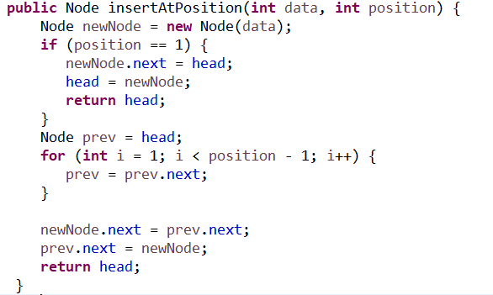
Insert @ given position of the Single Linked List

Slide 16
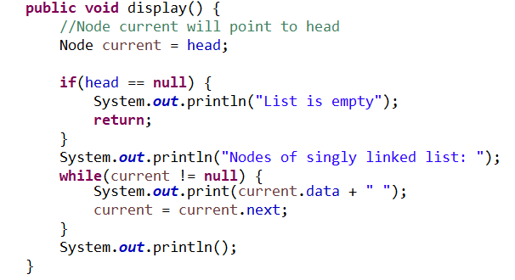
Display all the nodes present in the list

Slide 17
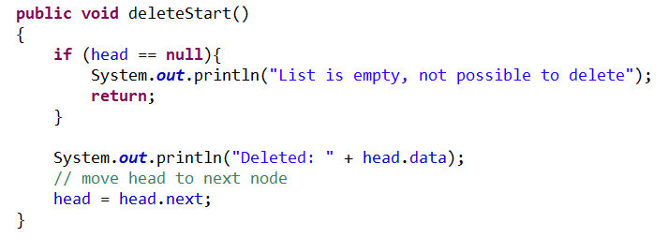
Delete @ beginning of the Single Linked List

Slide 18
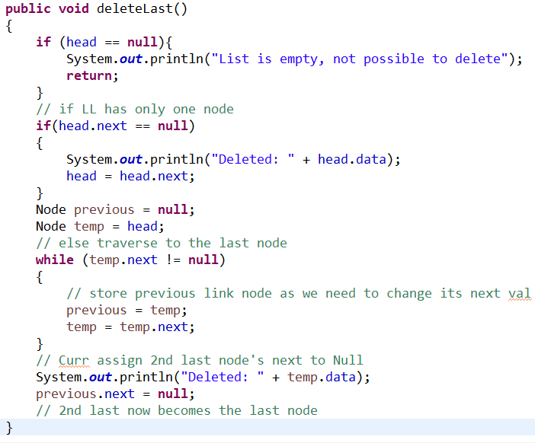
Delete last element of the Single Linked List

Slide 19
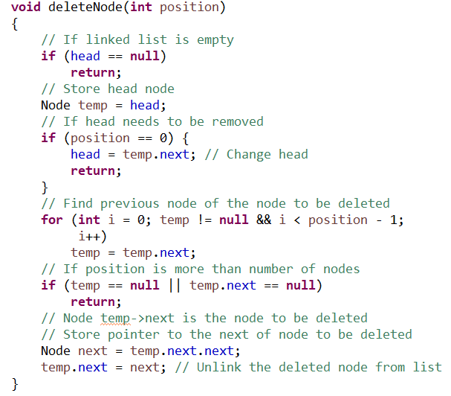
Delete node at given position the Single Linked List

